Slide 1

STATS 293 Applied Statistics with R
Chapter 1 – Notation & Expectation Algebra

Slide 2

1.1 - Summation notation and algebra for data presented in rows and columns

Slide 3

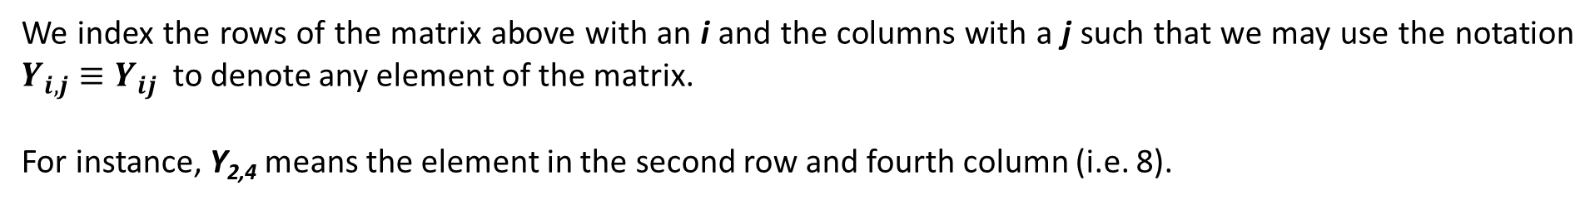
1.1 - Summation Notation & Algebra
1.1a - Summation Notation:
Suppose that we have N observations that can be grouped into r rows and c columns (N = rc).
$$\left[\begin{matrix}Y_{1,1} & Y_{1,2} & \begin{matrix}Y_{1,3} & Y_{1,4}\end{matrix} \\ Y_{2,1} & Y_{2,2} & \begin{matrix}Y_{2,3} & Y_{2,4}\end{matrix} \\ Y_{3,1} & Y_{3,2} & \begin{matrix}Y_{3,3} & Y_{3,4}\end{matrix}\end{matrix}\right] = \left[\begin{matrix}1 & 2 & \begin{matrix}3 & 4\end{matrix} \\ 5 & 6 & \begin{matrix}7 & 8\end{matrix} \\ 9 & 10 & \begin{matrix}11 & 12\end{matrix}\end{matrix}\right]$$
We index the rows of the matrix above with an i and the columns with a j such that we may use the notation $Y_{i,j}≡Y_{ij}$ to denote any element of the matrix.
For instance, Y_{2,4} means the element in the second row and fourth column (i.e. 8).
= 9
What is Y_{3,1} ?
What is Y_{2,2} ?
What is Y_{1,3} ?
= 6
= 3
3

Slide 4

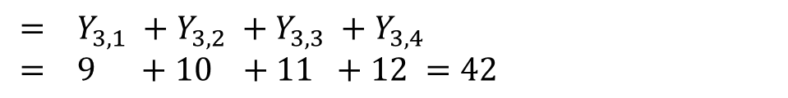
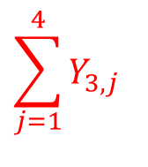
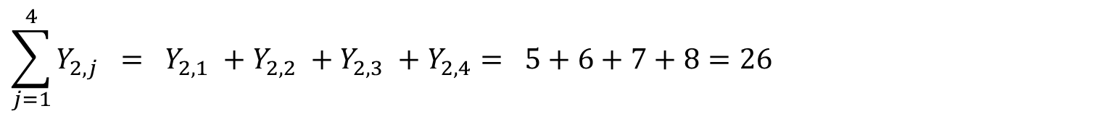
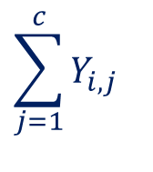
1.1 - Summation Notation & Algebra
1.1a - Summation Notation:
Suppose that we have N observations that can be grouped into r rows and c columns (N = rc).
$$\left[\begin{matrix}Y_{1,1} & Y_{1,2} & \begin{matrix}Y_{1,3} & Y_{1,4}\end{matrix} \\ Y_{2,1} & Y_{2,2} & \begin{matrix}Y_{2,3} & Y_{2,4}\end{matrix} \\ Y_{3,1} & Y_{3,2} & \begin{matrix}Y_{3,3} & Y_{3,4}\end{matrix}\end{matrix}\right] = \left[\begin{matrix}1 & 2 & \begin{matrix}3 & 4\end{matrix} \\ 5 & 6 & \begin{matrix}7 & 8\end{matrix} \\ 9 & 10 & \begin{matrix}11 & 12\end{matrix}\end{matrix}\right]$$
$$\sum_{j=1}^{c}{Y_{i,j}}$$
Means sum the i^{th} row
$$\sum_{j=1}^{4}{Y_{2,j}} = Y_{2,1} +Y_{2,2} +Y_{2,3} +Y_{2,4}= 5+6+7+8=26$$
$$\sum_{j=1}^{4}{Y_{3,j}}$$
How do we write the sum of the first row?
$$= Y_{3,1} +Y_{3,2} +Y_{3,3} +Y_{3,4} \\ = 9 +10 +11 +12 =42$$
$$\sum_{j=1}^{4}{Y_{1,j}}$$
4

Slide 5
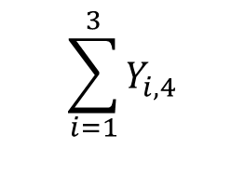
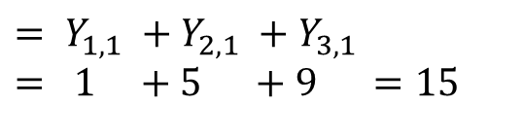

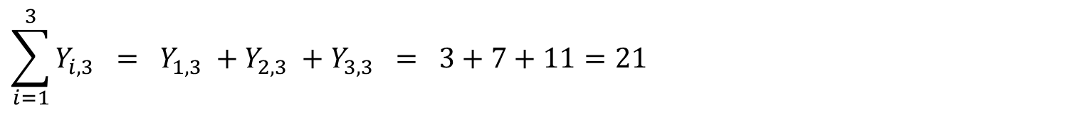
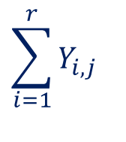
1.1 - Summation Notation & Algebra
1.1a - Summation Notation:
Suppose that we have N observations that can be grouped into r rows and c columns (N = rc).
$$\left[\begin{matrix}Y_{1,1} & Y_{1,2} & \begin{matrix}Y_{1,3} & Y_{1,4}\end{matrix} \\ Y_{2,1} & Y_{2,2} & \begin{matrix}Y_{2,3} & Y_{2,4}\end{matrix} \\ Y_{3,1} & Y_{3,2} & \begin{matrix}Y_{3,3} & Y_{3,4}\end{matrix}\end{matrix}\right] = \left[\begin{matrix}1 & 2 & \begin{matrix}3 & 4\end{matrix} \\ 5 & 6 & \begin{matrix}7 & 8\end{matrix} \\ 9 & 10 & \begin{matrix}11 & 12\end{matrix}\end{matrix}\right]$$
$$\sum_{i=1}^{r}{Y_{i,j}}$$
Means sum the j^{th} column
$$\sum_{i=1}^{3}{Y_{i,3}} = Y_{1,3} +Y_{2,3} +Y_{3,3} = 3+7+11=21$$
$$\sum_{i=1}^{3}{Y_{i,1}}$$
How do we write the sum of the fourth column?
$$= Y_{1,1} +Y_{2,1} +Y_{3,1} \\ = 1 +5 +9 =15$$
$$\sum_{i=1}^{3}{Y_{i,4}}$$
5

Slide 6
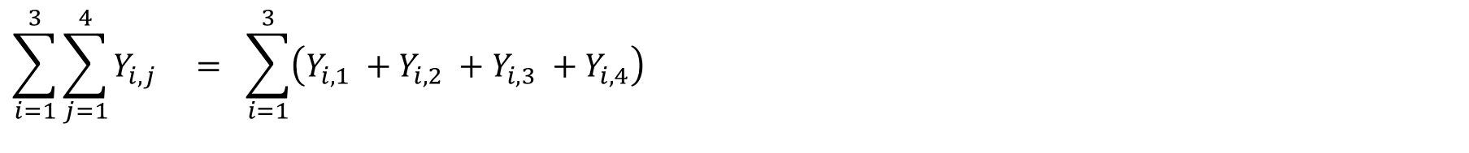

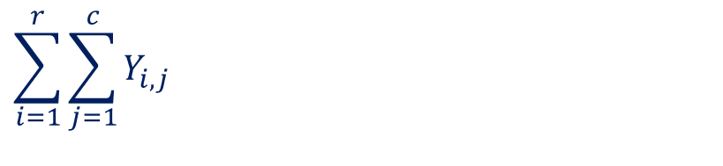
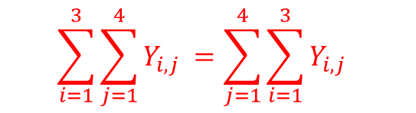
1.1 - Summation Notation & Algebra
1.1a - Summation Notation:
Suppose that we have N observations that can be grouped into r rows and c columns (N = rc).
$$\left[\begin{matrix}Y_{1,1} & Y_{1,2} & \begin{matrix}Y_{1,3} & Y_{1,4}\end{matrix} \\ Y_{2,1} & Y_{2,2} & \begin{matrix}Y_{2,3} & Y_{2,4}\end{matrix} \\ Y_{3,1} & Y_{3,2} & \begin{matrix}Y_{3,3} & Y_{3,4}\end{matrix}\end{matrix}\right] = \left[\begin{matrix}1 & 2 & \begin{matrix}3 & 4\end{matrix} \\ 5 & 6 & \begin{matrix}7 & 8\end{matrix} \\ 9 & 10 & \begin{matrix}11 & 12\end{matrix}\end{matrix}\right]$$
$$\sum_{i=1}^{r}{\sum_{j=1}^{c}{Y_{i,j}} }$$
Means sum all the elements of the matrix
$$\sum_{i=1}^{3}{\sum_{j=1}^{4}{Y_{i,j}} } = \sum_{i=1}^{3}{\left(Y_{i,1} +Y_{i,2} +Y_{i,3} +Y_{i,4}\right)}$$
$=\left(Y_{1,1} +Y_{1,2} +Y_{1,3} +Y_{1,4}\right)$ + $\left(Y_{2,1} +Y_{2,2} +Y_{2,3} +Y_{2,4}\right)$ + $\left(Y_{3,1} +Y_{3,2} +Y_{3,3} +Y_{3,4}\right)$
$$= \left( 1+2+3+4 \right) + \left( 5+6+7+8\right)+ \left( 9+10+11+12\right) = 78$$
$$\sum_{i=1}^{3}{\sum_{j=1}^{4}{Y_{i,j}} =\sum_{j=1}^{4}{\sum_{i=1}^{3}{Y_{i,j}} }}$$
In terms of the above example satisfy yourself that
6

Slide 7
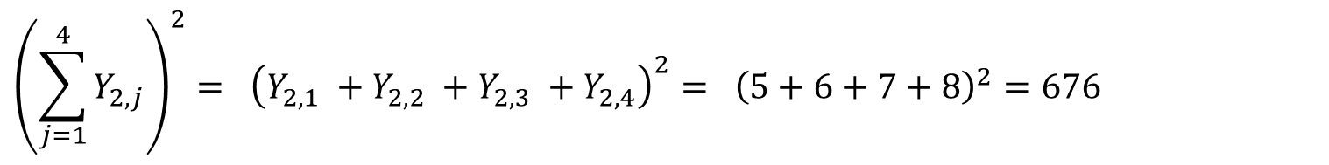
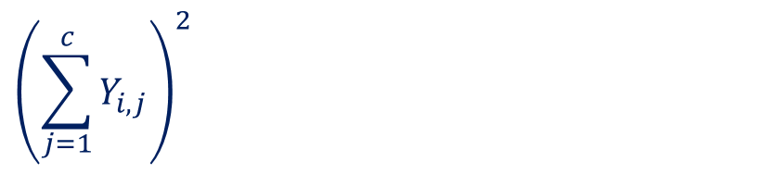
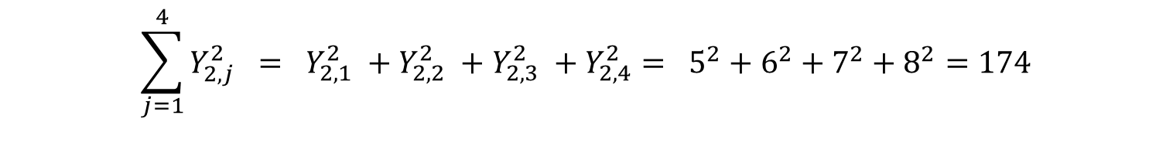
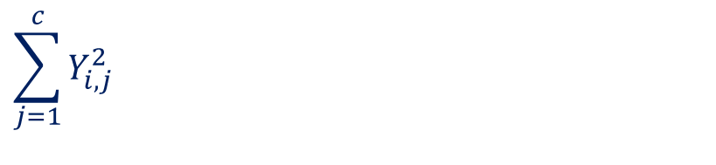

1.1 - Summation Notation & Algebra
1.1b - Bracket Notation:
Suppose that we have N observations that can be grouped into r rows and c columns (N = rc).
$$\left[\begin{matrix}Y_{1,1} & Y_{1,2} & \begin{matrix}Y_{1,3} & Y_{1,4}\end{matrix} \\ Y_{2,1} & Y_{2,2} & \begin{matrix}Y_{2,3} & Y_{2,4}\end{matrix} \\ Y_{3,1} & Y_{3,2} & \begin{matrix}Y_{3,3} & Y_{3,4}\end{matrix}\end{matrix}\right] = \left[\begin{matrix}1 & 2 & \begin{matrix}3 & 4\end{matrix} \\ 5 & 6 & \begin{matrix}7 & 8\end{matrix} \\ 9 & 10 & \begin{matrix}11 & 12\end{matrix}\end{matrix}\right]$$
$$\sum_{j=1}^{c}{Y_{i,j}^{2}}$$
Means square each element of the i^{th} row and sum the result
$$\sum_{j=1}^{4}{Y_{2,j}^{2}} = Y_{2,1}^{2} +Y_{2,2}^{2} +Y_{2,3}^{2} +Y_{2,4}^{2}= 5^{2}+6^{2}+7^{2}+8^{2}=174$$
$${\left(\sum_{j=1}^{c}{Y_{i,j}}\right)}^{2}$$
Means sum the elements of the i^{th} row and then square the result
$${\left(\sum_{j=1}^{4}{Y_{2,j}}\right)}^{2}= {\left(Y_{2,1} +Y_{2,2} +Y_{2,3} +Y_{2,4}\right)}^{2}= {\left(5+6+7+8\right)}^{2}=676$$
$$\sum_{j=1}^{c}{Y_{i,j}^{2}} ≠{\left(\sum_{j=1}^{c}{Y_{i,j}}\right)}^{2}$$
Note that in general
7

Slide 8
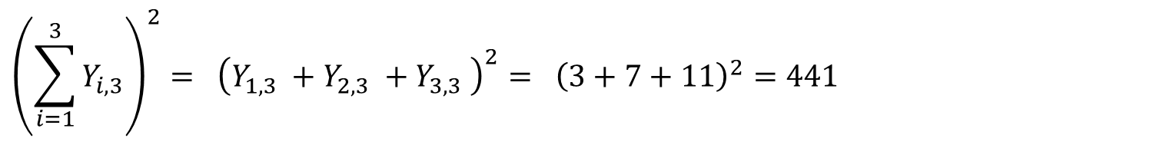
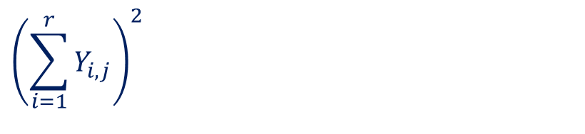

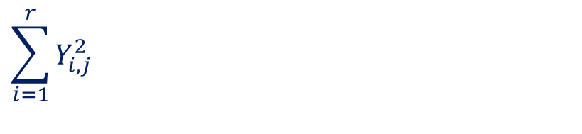

1.1 - Summation Notation & Algebra
1.1b - Bracket Notation:
Suppose that we have N observations that can be grouped into r rows and c columns (N = rc).
$$\left[\begin{matrix}Y_{1,1} & Y_{1,2} & \begin{matrix}Y_{1,3} & Y_{1,4}\end{matrix} \\ Y_{2,1} & Y_{2,2} & \begin{matrix}Y_{2,3} & Y_{2,4}\end{matrix} \\ Y_{3,1} & Y_{3,2} & \begin{matrix}Y_{3,3} & Y_{3,4}\end{matrix}\end{matrix}\right] = \left[\begin{matrix}1 & 2 & \begin{matrix}3 & 4\end{matrix} \\ 5 & 6 & \begin{matrix}7 & 8\end{matrix} \\ 9 & 10 & \begin{matrix}11 & 12\end{matrix}\end{matrix}\right]$$
$$\sum_{i=1}^{r}{Y_{i,j}^{2}}$$
Means square each element of the j^{th} column and sum the result
$$\sum_{i=1}^{3}{Y_{i,3}^{2}} = Y_{1,3}^{2} +Y_{2,3}^{2} +Y_{3,3}^{2} = 3^{2}+7^{2}+{11}^{2}=179$$
$${\left(\sum_{i=1}^{r}{Y_{i,j}}\right)}^{2}$$
Means sum the elements of the j^{th} column and then square the result
$${\left(\sum_{i=1}^{3}{Y_{i,3}}\right)}^{2}= {\left(Y_{1,3} +Y_{2,3} +Y_{3,3} \right)}^{2}= {\left(3+7+11\right)}^{2}=441$$
$$\sum_{i=1}^{r}{Y_{i,j}^{2}} ≠{\left(\sum_{i=1}^{r}{Y_{i,j}}\right)}^{2}$$
Note that in general
8

Slide 9

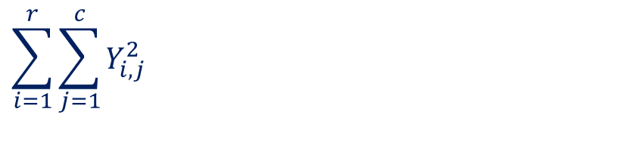
1.1 - Summation Notation & Algebra
1.1b - Bracket Notation:
Suppose that we have N observations that can be grouped into r rows and c columns (N = rc).
$$\left[\begin{matrix}Y_{1,1} & Y_{1,2} & \begin{matrix}Y_{1,3} & Y_{1,4}\end{matrix} \\ Y_{2,1} & Y_{2,2} & \begin{matrix}Y_{2,3} & Y_{2,4}\end{matrix} \\ Y_{3,1} & Y_{3,2} & \begin{matrix}Y_{3,3} & Y_{3,4}\end{matrix}\end{matrix}\right] = \left[\begin{matrix}1 & 2 & \begin{matrix}3 & 4\end{matrix} \\ 5 & 6 & \begin{matrix}7 & 8\end{matrix} \\ 9 & 10 & \begin{matrix}11 & 12\end{matrix}\end{matrix}\right]$$
$$\sum_{i=1}^{r}{\sum_{j=1}^{c}{Y_{i,j}^{2}}}$$
Means square each element of the matrix and sum the result
$$\sum_{i=1}^{3}{\sum_{j=1}^{4}{Y_{i,j}^{2}}}=1^{2} +2^{2}+3^{2}+ ⋯ + {11}^{2} + {12}^{2} =650$$
9

Slide 10
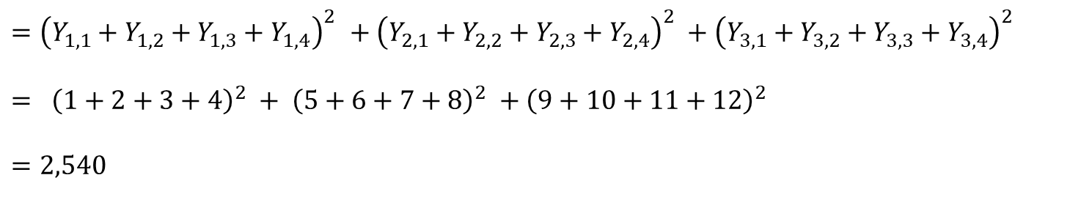
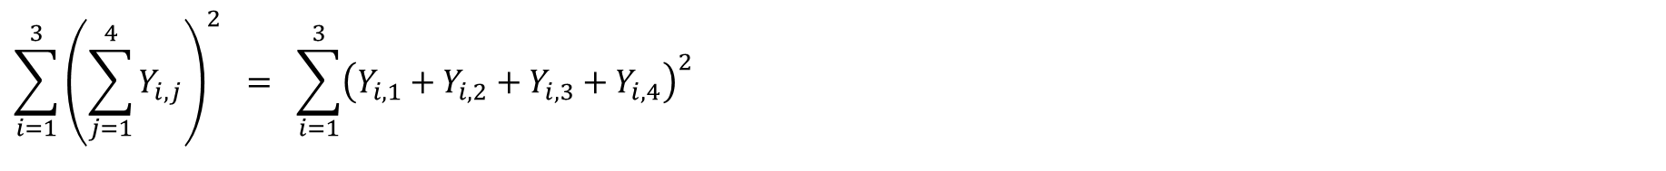
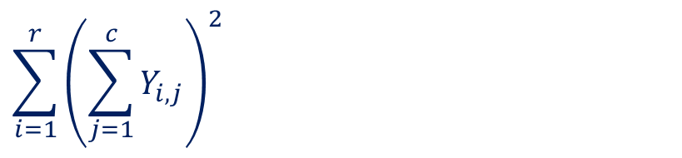
1.1 - Summation Notation & Algebra
1.1b - Bracket Notation:
Suppose that we have N observations that can be grouped into r rows and c columns (N = rc).
$$\left[\begin{matrix}Y_{1,1} & Y_{1,2} & \begin{matrix}Y_{1,3} & Y_{1,4}\end{matrix} \\ Y_{2,1} & Y_{2,2} & \begin{matrix}Y_{2,3} & Y_{2,4}\end{matrix} \\ Y_{3,1} & Y_{3,2} & \begin{matrix}Y_{3,3} & Y_{3,4}\end{matrix}\end{matrix}\right] = \left[\begin{matrix}1 & 2 & \begin{matrix}3 & 4\end{matrix} \\ 5 & 6 & \begin{matrix}7 & 8\end{matrix} \\ 9 & 10 & \begin{matrix}11 & 12\end{matrix}\end{matrix}\right]$$
$$\sum_{i=1}^{r}{{\left(\sum_{j=1}^{c}{Y_{i,j}}\right)}^{2}}$$
Means sum the elements of each row, square the result and add together
$$\sum_{i=1}^{3}{{\left(\sum_{j=1}^{4}{Y_{i,j}}\right)}^{2}} = \sum_{i=1}^{3}{{\left(Y_{i,1}+Y_{i,2}+Y_{i,3}+Y_{i,4}\right)}^{2}}$$
$${=\left(Y_{1,1}+Y_{1,2}+Y_{1,3}+Y_{1,4}\right)}^{2} + {\left(Y_{2,1}+Y_{2,2}+Y_{2,3}+Y_{2,4}\right)}^{2} +{ \left(Y_{3,1}+Y_{3,2}+Y_{3,3}+Y_{3,4}\right)}^{2}$$
$$= {\left(1+2+3+4\right)}^{2} + {\left(5+6+7+8\right)}^{2} +{ \left(9+10+11+12\right)}^{2}$$
$$=2,540$$
10

Slide 11
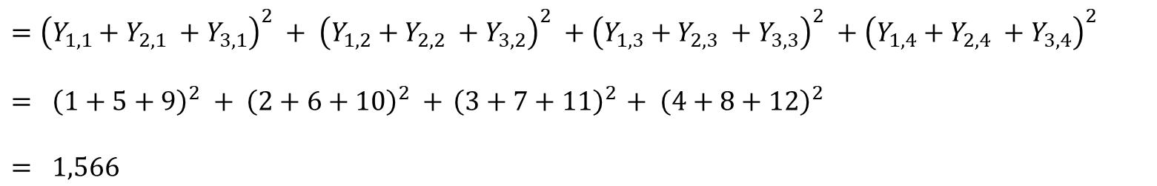
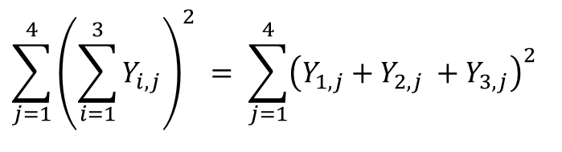
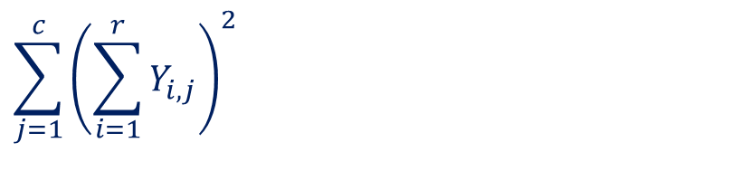
1.1 - Summation Notation & Algebra
1.1b - Bracket Notation:
Suppose that we have N observations that can be grouped into r rows and c columns (N = rc).
$$\left[\begin{matrix}Y_{1,1} & Y_{1,2} & \begin{matrix}Y_{1,3} & Y_{1,4}\end{matrix} \\ Y_{2,1} & Y_{2,2} & \begin{matrix}Y_{2,3} & Y_{2,4}\end{matrix} \\ Y_{3,1} & Y_{3,2} & \begin{matrix}Y_{3,3} & Y_{3,4}\end{matrix}\end{matrix}\right] = \left[\begin{matrix}1 & 2 & \begin{matrix}3 & 4\end{matrix} \\ 5 & 6 & \begin{matrix}7 & 8\end{matrix} \\ 9 & 10 & \begin{matrix}11 & 12\end{matrix}\end{matrix}\right]$$
$$\sum_{j=1}^{c}{{\left(\sum_{i=1}^{r}{Y_{i,j}}\right)}^{2}}$$
Means sum the elements of each column, square the result and add together
$$\sum_{j=1}^{4}{{\left(\sum_{i=1}^{3}{Y_{i,j}}\right)}^{2} }= \sum_{j=1}^{4}{{\left(Y_{1,j}+Y_{2,j} +Y_{3,j}\right)}^{2}}$$
$$={\left(Y_{1,1}+Y_{2,1} +Y_{3,1}\right)}^{2} + {\left(Y_{1,2}+Y_{2,2} +Y_{3,2}\right)}^{2} +{\left(Y_{1,3}+Y_{2,3} +Y_{3,3}\right)}^{2} +{\left(Y_{1,4}+Y_{2,4} +Y_{3,4}\right)}^{2}$$
$$= {\left(1+5+9\right)}^{2} + {\left(2+6+10\right)}^{2} +{ \left(3+7+11\right)}^{2} + { \left(4+8+12\right)}^{2}$$
$$= 1,566$$
11

Slide 12
1.2 - Bar-Dot Notation Commonly used shorthand notation in Analysis of Variance

Slide 13
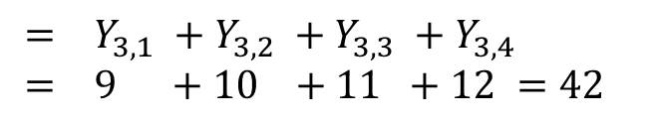
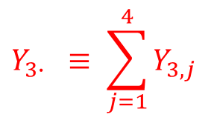
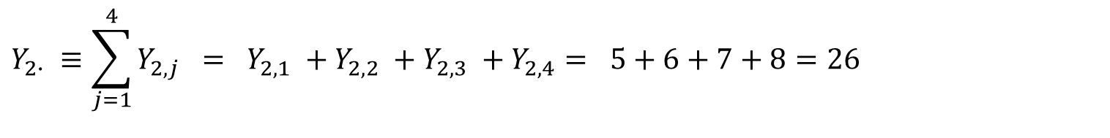

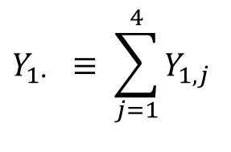
1.2 - Bar-Dot Notation
1.2a - Dot Notation for Row Sums:
Suppose that we have N observations that can be grouped into r rows and c columns (N = rc).
$$\left[\begin{matrix}Y_{1,1} & Y_{1,2} & \begin{matrix}Y_{1,3} & Y_{1,4}\end{matrix} \\ Y_{2,1} & Y_{2,2} & \begin{matrix}Y_{2,3} & Y_{2,4}\end{matrix} \\ Y_{3,1} & Y_{3,2} & \begin{matrix}Y_{3,3} & Y_{3,4}\end{matrix}\end{matrix}\right] = \left[\begin{matrix}1 & 2 & \begin{matrix}3 & 4\end{matrix} \\ 5 & 6 & \begin{matrix}7 & 8\end{matrix} \\ 9 & 10 & \begin{matrix}11 & 12\end{matrix}\end{matrix}\right]$$
$$Y_{i∙} ≡\sum_{j=1}^{c}{Y_{i,j}}$$
Means sum the i^{th} row
$$Y_{2∙} ≡\sum_{j=1}^{4}{Y_{2,j}} = Y_{2,1} +Y_{2,2} +Y_{2,3} +Y_{2,4}= 5+6+7+8=26$$
$$Y_{3∙} ≡ \sum_{j=1}^{4}{Y_{3,j}}$$
How do we write the sum of the first row in dot notation?
$$= Y_{3,1} +Y_{3,2} +Y_{3,3} +Y_{3,4} \\ = 9 +10 +11 +12 =42$$
$$Y_{1∙} ≡ \sum_{j=1}^{4}{Y_{1,j}}$$
13

Slide 14
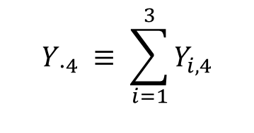
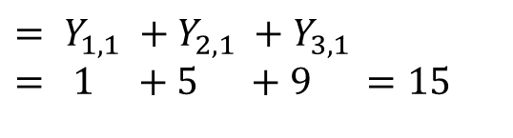
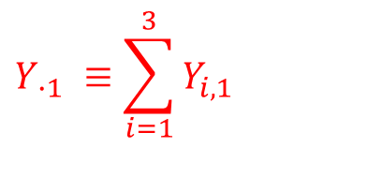
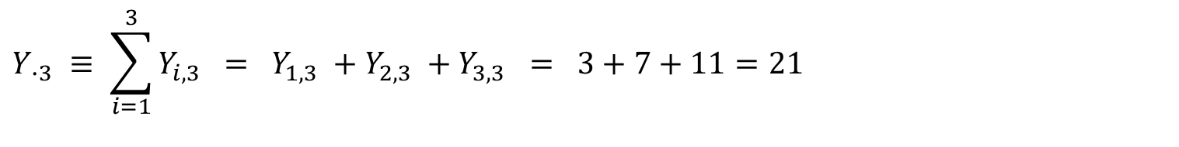
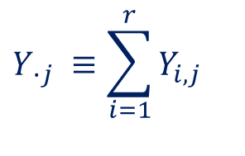
1.2 - Bar-Dot Notation
1.2b - Dot Notation for Column Sums:
Suppose that we have N observations that can be grouped into r rows and c columns (N = rc).
$$\left[\begin{matrix}Y_{1,1} & Y_{1,2} & \begin{matrix}Y_{1,3} & Y_{1,4}\end{matrix} \\ Y_{2,1} & Y_{2,2} & \begin{matrix}Y_{2,3} & Y_{2,4}\end{matrix} \\ Y_{3,1} & Y_{3,2} & \begin{matrix}Y_{3,3} & Y_{3,4}\end{matrix}\end{matrix}\right] = \left[\begin{matrix}1 & 2 & \begin{matrix}3 & 4\end{matrix} \\ 5 & 6 & \begin{matrix}7 & 8\end{matrix} \\ 9 & 10 & \begin{matrix}11 & 12\end{matrix}\end{matrix}\right]$$
$$Y_{ ∙j} ≡\sum_{i=1}^{r}{Y_{i,j}}$$
Means sum the j^{th} column
$$Y_{ ∙3} ≡ \sum_{i=1}^{3}{Y_{i,3}} = Y_{1,3} +Y_{2,3} +Y_{3,3} = 3+7+11=21$$
$$Y_{ ∙1} ≡\sum_{i=1}^{3}{Y_{i,1}}$$
How do we write the sum of the fourth column in dot notation?
$$= Y_{1,1} +Y_{2,1} +Y_{3,1} \\ = 1 +5 +9 =15$$
$$Y_{ ∙4} ≡ \sum_{i=1}^{3}{Y_{i,4}}$$
14

Slide 15
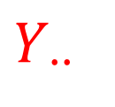
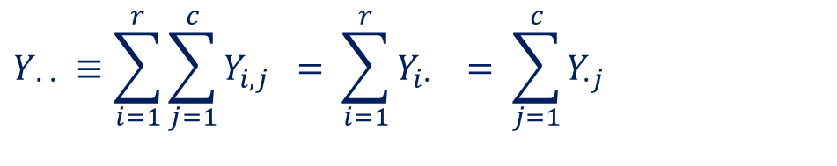
1.2 - Bar-Dot Notation
1.2c - Dot Notation for Grand Sums:
Suppose that we have N observations that can be grouped into r rows and c columns (N = rc).
$$\left[\begin{matrix}Y_{1,1} & Y_{1,2} & \begin{matrix}Y_{1,3} & Y_{1,4}\end{matrix} \\ Y_{2,1} & Y_{2,2} & \begin{matrix}Y_{2,3} & Y_{2,4}\end{matrix} \\ Y_{3,1} & Y_{3,2} & \begin{matrix}Y_{3,3} & Y_{3,4}\end{matrix}\end{matrix}\right] = \left[\begin{matrix}1 & 2 & \begin{matrix}3 & 4\end{matrix} \\ 5 & 6 & \begin{matrix}7 & 8\end{matrix} \\ 9 & 10 & \begin{matrix}11 & 12\end{matrix}\end{matrix}\right]$$
$$Y_{ ∙ ∙} ≡\sum_{i=1}^{r}{\sum_{j=1}^{c}{Y_{i,j}} }= \sum_{i=1}^{r}{Y_{i∙} } = \sum_{j=1}^{c}{Y_{∙j}}$$
Means sum all the elements of the matrix
$$Y_{ ∙∙}$$
$$= \left( 1+2+3+4 \right) + \left( 5+6+7+8\right)+ \left( 9+10+11+12\right) = 78$$
15

Slide 16
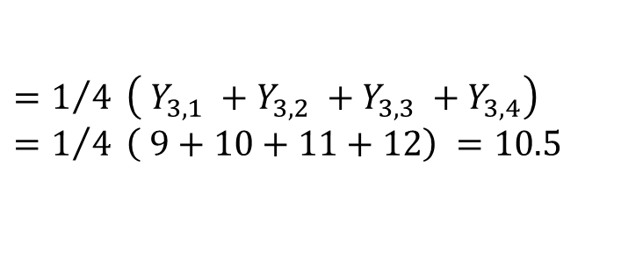

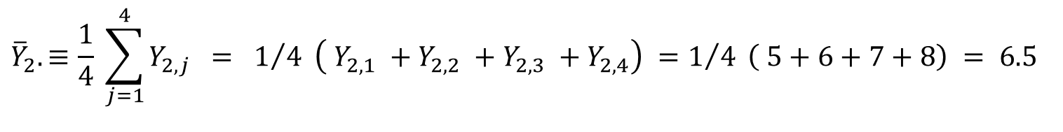
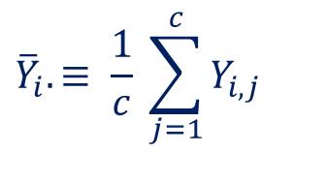
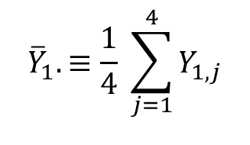
1.2 - Bar-Dot Notation
1.2d - Bar-Dot Notation for Row Means:
Suppose that we have N observations that can be grouped into r rows and c columns (N = rc).
$$\left[\begin{matrix}Y_{1,1} & Y_{1,2} & \begin{matrix}Y_{1,3} & Y_{1,4}\end{matrix} \\ Y_{2,1} & Y_{2,2} & \begin{matrix}Y_{2,3} & Y_{2,4}\end{matrix} \\ Y_{3,1} & Y_{3,2} & \begin{matrix}Y_{3,3} & Y_{3,4}\end{matrix}\end{matrix}\right] = \left[\begin{matrix}1 & 2 & \begin{matrix}3 & 4\end{matrix} \\ 5 & 6 & \begin{matrix}7 & 8\end{matrix} \\ 9 & 10 & \begin{matrix}11 & 12\end{matrix}\end{matrix}\right]$$
$${\overline{Y}}_{i}.≡ \frac{1}{c} \sum_{j=1}^{c}{Y_{i,j}}$$
Means take the average of the i^{th} row
$${\overline{Y}}_{2}. ≡\frac{1}{4} \sum_{j=1}^{4}{Y_{2,j}} = 1/{4 }\left( Y_{2,1} +Y_{2,2} +Y_{2,3} +Y_{2,4}\right) =1/{4 }\left( 5+6+7+8\right) = 6.5$$
$${\overline{Y}}_{3}.≡ \frac{1}{4} \sum_{j=1}^{4}{Y_{3,j}}$$
$$=1/{4 }\left( Y_{3,1} +Y_{3,2} +Y_{3,3} +Y_{3,4}\right) =1/{4 }\left( 9+10+11+12\right) =10.5$$
How do we write the average of the first row in bar-dot notation?
$${\overline{Y}}_{1}. ≡\frac{1}{4} \sum_{j=1}^{4}{Y_{1,j}}$$
16

Slide 17
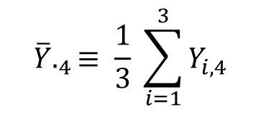
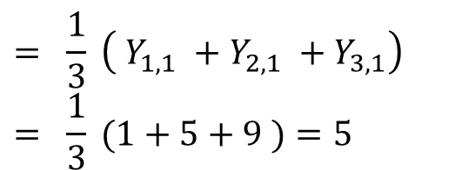

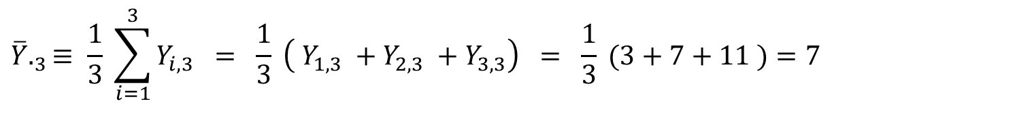
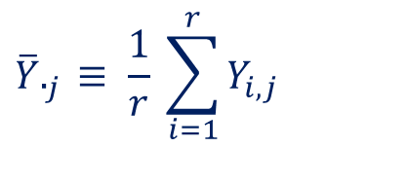
1.2 - Bar-Dot Notation
1.2e - Bar-Dot Notation for Column Means:
Suppose that we have N observations that can be grouped into r rows and c columns (N = rc).
$$\left[\begin{matrix}Y_{1,1} & Y_{1,2} & \begin{matrix}Y_{1,3} & Y_{1,4}\end{matrix} \\ Y_{2,1} & Y_{2,2} & \begin{matrix}Y_{2,3} & Y_{2,4}\end{matrix} \\ Y_{3,1} & Y_{3,2} & \begin{matrix}Y_{3,3} & Y_{3,4}\end{matrix}\end{matrix}\right] = \left[\begin{matrix}1 & 2 & \begin{matrix}3 & 4\end{matrix} \\ 5 & 6 & \begin{matrix}7 & 8\end{matrix} \\ 9 & 10 & \begin{matrix}11 & 12\end{matrix}\end{matrix}\right]$$
$$\overline{Y}._{j} ≡ \frac{1}{r} \sum_{i=1}^{r}{Y_{i,j}}$$
Means take the average of the j^{th} column
$$\overline{Y}._{3}≡ \frac{1}{3} \sum_{i=1}^{3}{Y_{i,3}} = \frac{1}{3} \left( Y_{1,3} +Y_{2,3} +Y_{3,3}\right) = \frac{1}{3} (3+7+11 )=7$$
$$\overline{Y}._{1}≡ \frac{1}{3} \sum_{i=1}^{3}{Y_{i,1}}$$
$$= \frac{1}{3} \left( Y_{1,1} +Y_{2,1} +Y_{3,1}\right) \\ = \frac{1}{3} (1+5+9 )=5$$
How do we write the average of the fourth column in bar-dot notation?
$$\overline{Y}._{4}≡ \frac{1}{3} \sum_{i=1}^{3}{Y_{i,4}}$$
17

Slide 18


1.2 - Bar-Dot Notation
1.2f - Bar-Dot Notation for Grand Means:
Suppose that we have N observations that can be grouped into r rows and c columns (N = rc).
$$\left[\begin{matrix}Y_{1,1} & Y_{1,2} & \begin{matrix}Y_{1,3} & Y_{1,4}\end{matrix} \\ Y_{2,1} & Y_{2,2} & \begin{matrix}Y_{2,3} & Y_{2,4}\end{matrix} \\ Y_{3,1} & Y_{3,2} & \begin{matrix}Y_{3,3} & Y_{3,4}\end{matrix}\end{matrix}\right] = \left[\begin{matrix}1 & 2 & \begin{matrix}3 & 4\end{matrix} \\ 5 & 6 & \begin{matrix}7 & 8\end{matrix} \\ 9 & 10 & \begin{matrix}11 & 12\end{matrix}\end{matrix}\right]$$
$$\overline{Y_{ }}.. ≡ \frac{1}{rc} \sum_{i=1}^{r}{\sum_{j=1}^{c}{Y_{i,j}} }= \frac{1}{rc} \sum_{i=1}^{r}{Y_{i∙} } = \frac{1}{rc} \sum_{j=1}^{c}{Y_{∙j}}$$
Means take the average of all elements
$$\overline{Y_{ }}..$$
$$= \frac{1}{12} \left[\left( 1+2+3+4 \right) + \left( 5+6+7+8\right)+ \left( 9+10+11+12\right)\right]= \frac{78}{12} = 6.5$$
18

Slide 19
1.3 - Expectation and Variance of a Random Variable

Slide 20



1.3 – Expectation & Variance of RVs
1.3a - Random Variables:
A random variable X is an experiment with an unknown outcome. If X can only take certain discrete outcomes it is known as a discrete r.v. If X can take any value in a given interval [a,b] it is known as a continuous r.v.
Discrete
Continuous
A probability mass function P_{X} is a mapping from outcomes of X to the real line with the properties that:
$0≤P_{X}\left(x_{i}\right)≤1$
$\sum_{i=1}^{n}{P_{X}\left(x_{i}\right)=1}$
A probability density function f_{X} is a mapping from outcomes of X to the real line with the properties that:
$f_{X}\left(x\right)≥0$
$\int_{a}^{b}{f_{X}\left(x\right)}dx =1$
Example - # Heads out of three coin-tosses
Example – A r.v. that is equally likely to take any value in the interval [0,10]
 | X=0 | X=1 | X=2 | X=3
P(X = x) | 1/8 | 3/8 | 3/8 | 1/8
We say that $X \sim U(0,10)$
$$f_{X}\left(x\right)=\frac{1}{10}$$
$$\int_{x=0}^{x=10}{\frac{1}{10}} dx = {{\left[ \frac{x}{10} \right]}_{x=0}^{x=10}}_{} = 1$$
20

Slide 21




1.3 – Expectation & Variance of RVs
1.3b - Expectation of a Random Variable:
The expectation of a random variable E[X] is a probability weighted average of the outcomes of X. Its the value you would get if you repeated the experiment many-many times and averaged all the outcomes.
Discrete
Continuous
The expectation of a discrete random variable is calculated according to the formula:
$$E\left[X\right]= \sum_{i=1}^{n}{x_{i} ∗P_{X}(x_{i})}$$
The expectation of a continuous random variable is calculated according to the formula:
$$E\left[X\right]= \int_{a}^{b}{x ∗f_{X}\left(x\right)} dx$$
Example - # Heads out of three coin-tosses
Example – $X \sim U(0,10)$
 | X=0 | X=1 | X=2 | X=3
P(X = x) | 1/8 | 3/8 | 3/8 | 1/8
$$E\left[X\right]= \int_{x=0}^{x=10}{x ∗\frac{1}{10}} dx = {{\left[ \frac{x^{2}}{20} \right]}_{x=0}^{x=10}}_{} =5$$
$$E\left[X\right] = 0 ∗\frac{1}{8} + 1∗\frac{3}{8} + 2∗\frac{3}{8} + 3 ∗\frac{1}{8} =1.5$$
21

Slide 22




1.3 – Expectation & Variance of RVs
1.3c - Expectation of a Function of a Random Variable:
The expectation of a function g of random variable X is denoted by E[g(X)]. It is a probability weighted average of the outcomes of X under the image of g. Whilst this sounds complicated… it really isn’t!
Discrete
Continuous
The expectation of a discrete random variable under the image of the function g is calculated according to the formula:
$$E\left[g(X)\right]= \sum_{i=1}^{n}{g(x_{i}) ∗P_{X}(x_{i})}$$
The expectation of a continuous random variable under the image of the function g is calculated according to the formula:
$$E\left[g(X)\right]= \int_{a}^{b}{g(x) ∗f_{X}\left(x\right)}dx$$
Example - # Heads out of three coin-tosses and g(x) = X²
Example – $X \sim U(0,10)$ and g(x) = x²
 | X=0 | X=1 | X=2 | X=3
P(X = x) | 1/8 | 3/8 | 3/8 | 1/8
$$E\left[X^{2}\right]= \int_{x=0}^{x=10}{x^{2} ∗\frac{1}{10}} dx = {{\left[ \frac{x^{3}}{30} \right]}_{x=0}^{x=10}}_{} =100/3$$
$$E\left[X^{2}\right] ={\left(0\right)}^{2} ∗\frac{1}{8} + {\left(1\right)}^{2}∗\frac{3}{8} + {\left(2\right)}^{2}∗\frac{3}{8} + {\left(3\right)}^{2} ∗\frac{1}{8} = 3$$
22

Slide 23





1.3 – Expectation & Variance of RVs
1.3d - Facts About Expectation:
Expectation is a linear operator, i.e. $E\left[ aX+b \right]=a E\left[X\right]+b$
a and b are just numbers
Proof in the discrete case (FYI Only):
$$E\left[ aX+b \right] = \sum_{i=1}^{n}{ \left( a x_{i} +b \right)∗P_{X}\left(x_{i}\right)}$$
$$= \sum_{i=1}^{n}{\left[ a x_{i}∗P_{X}\left(x_{i}\right) + b P_{X}\left(x_{i}\right) \right]}$$
$$=\sum_{i=1}^{n}{a x_{i}∗P_{X}\left(x_{i}\right)} + \sum_{i=1}^{n}{{b P}_{X}\left(x_{i}\right)}$$
$$= a \sum_{i=1}^{n}{x_{i}∗P_{X}\left(x_{i}\right)} + b \sum_{i=1}^{n}{P_{X}\left(x_{i}\right)}$$
$$= a E\left[X\right]+b$$
= E[X]
=1
Optional Exercise: Try proving this for yourself in the continuous case!
23

Slide 24
1.3 – Expectation & Variance of RVs
1.3d - Facts About Expectation:
Expectation is a linear operator, i.e. $E\left[ aX+b \right]=a E\left[X\right]+b$
a and b are just numbers
$E\left[ aX \right]=a E\left[X\right]$
Holds immediately from 1 (let b = 0)
$E\left[ b \right]=b$
Holds immediately from 1 (let a = 0)
$E\left[ X+Y \right]=E\left[ X \right]+ E[ Y ]$
X and Y are random variables
If X and Y are two independent* random variables (i.e. the outcome of one has no bearing on the outcome of the other) $E\left[ XY \right] = E\left[X\right] ∗ E[Y]$
24
* This will always be the case in STAT 293

Slide 25

1.3 – Expectation & Variance of RVs
1.3e - Variance of a Random Variable:
The variance of a random variable X is the average squared distance of outcomes of X from its expected value. The variance gives an indication of how spread out the outcomes of X are.
A large variance indicates that the outcomes of X are highly spread out around the expected value.
$$Var\left[X\right] ≡ E \left[{ \left( X −E\left[X\right] \right)}^{2}\right] = E\left[X^{2}\right] − ( E{\left[X\right] )}^{2}$$
Proof of Equivalence (FYI Only):
It is often much easier to do calculations with this formula!
$$Var\left[X\right] ≡ E \left[{ \left( X −E\left[X\right] \right)}^{2} \right] = E\left[ \left( X −E\left[X\right] \right) ∗ \left( X −E\left[X\right] \right) \right]$$
$= E\left[ X^{2} + {\left( E\left[X\right] \right)}^{2} −2 E\left[X\right] X \right]$
Note E[X] is just a number. So let E[X] = μ
$= E\left[ X^{2} + μ^{2} − 2 μ X \right]$
$= E\left[ X^{2} ] + E[ μ^{2} ] − E[ 2 μ X \right]$
$$= E \left[X^{2}\right] + μ^{2} − 2 μ E\left[X\right]$$
Since μ = E[X]
$$= E \left[X^{2}\right] + {\left( E\left[X\right] \right)}^{2} − 2{\left( E\left[X\right] \right)}^{2}$$
1. $E\left[ aX+b \right]=a E\left[X\right]+b$ 2. $E\left[ aX \right]=a E\left[X\right]$
3. $E\left[ b \right]=b$ 4. $E\left[ X+Y \right]=E\left[ X \right]+ E[ Y ]$
$$= E \left[X^{2}\right] − {\left( E\left[X\right] \right)}^{2}$$
25

Slide 26






1.3 – Expectation & Variance of RVs
1.3f - Examples of Calculating Variance:
$$Var\left[X\right] ≡ E \left[{ \left( X −E\left[X\right] \right)}^{2}\right] = E\left[X^{2}\right] − ( E{\left[X\right] )}^{2}$$
Discrete
Continuous
Example - # Heads out of three coin-tosses
Example – $X \sim U(0,10)$
 | X=0 | X=1 | X=2 | X=3
P(X = x) | 1/8 | 3/8 | 3/8 | 1/8
$$E\left[X\right]= \int_{x=0}^{x=10}{x ∗\frac{1}{10}} dx = {{\left[ \frac{x^{2}}{20} \right]}_{X=0}^{x=10}}_{} =5$$
$$E\left[X^{2}\right]= \int_{x=0}^{x=10}{x^{2} ∗\frac{1}{10}} dx = {{\left[ \frac{x^{3}}{30} \right]}_{X=0}^{x=10}}_{} =100/3$$
$$E\left[X\right] = 0 ∗\frac{1}{8} + 1∗\frac{3}{8} + 2∗\frac{3}{8} + 3 ∗\frac{1}{8} =1.5$$
$$E\left[X^{2}\right] ={\left(0\right)}^{2} ∗\frac{1}{8} + {\left(1\right)}^{2}∗\frac{3}{8} + {\left(2\right)}^{2}∗\frac{3}{8} + {\left(3\right)}^{2} ∗\frac{1}{8} = 3$$
$$Var\left[X\right]=E\left[X^{2}\right]−{\left( E\left[X\right] \right)}^{2} =3 −{1.5}^{2} = 0.75$$
$Var\left[X\right]=E\left[X^{2}\right]−{\left( E\left[X\right] \right)}^{2} =100/3 −5^{2} = 25/3$ ≈ 8.3333
E[X] = 1.5
E[X] = 5
26
0
1
2
3
0
10

Slide 27




1.3 – Expectation & Variance of RVs
1.3g - A Fact About Variance:
1. $E\left[ aX+b \right]=a E\left[X\right]+b$ 2. $E\left[ aX \right]=a E\left[X\right]$
3. $E\left[ b \right]=b$ 4. $E\left[ X+Y \right]=E\left[ X \right]+ E[ Y ]$
a and b are just numbers
Variance is not a linear operator, i.e. $Var\left[ aX+b \right]=a^{2} Var\left[X\right]$
Proof (FYI Only):
$$Var\left[ aX+b \right] = E\left[ {\left(aX+b\right)}^{2} \right] − {\left( E\left[ aX+b \right] \right)}^{2}$$
Var[ Y ] = E[ Y² ] – ( E[ Y ] )²
$$= E\left[ {\left(aX+b\right)}^{2} \right] − {\left( a E\left[X\right]+b \right)}^{2}$$
$= E\left[ \left(aX+b\right) \left(aX+b\right) \right] −$ $\left( a E\left[X\right]+b \right)$ $\left( a E\left[X\right]+b \right)$
$= E\left[ a^{2} X^{2}+ b^{2} + 2abX \right] −$ $\left( a^{2} {\left( E\left[X\right] \right)}^{2} + b^{2} + 2ab E[X] \right)$
$= E\left[ a^{2} X^{2} ] + E[ b^{2} ] + E[ 2abX \right] −$ $\left( a^{2} {\left( E\left[X\right] \right)}^{2} + b^{2} + 2ab E[X] \right)$
$= a^{2} E\left[X^{2}\right] + b^{2} + 2ab E\left[X\right]$ $− a^{2} {\left( E\left[X\right] \right)}^{2} − b^{2} − 2ab E\left[X\right]$
✓
✓
✓
✓
$$= a^{2} E\left[X^{2}\right] − a^{2 }{\left( E\left[X\right] \right)}^{2}$$
$$= a^{2} ( E\left[X^{2}\right] − {\left( E\left[X\right] \right)}^{2} )$$
$$= a^{2} Var[X]$$
27

Slide 28
1.3 – Expectation & Variance of RVs
1.3h - The Covariance of Random Variables:
Suppose we have two random variables X and Y. The covariance of X and Y measures how the two variables move in relation to each other (i.e. does Y tend to increase or decrease as X increases?).
$$Cov\left[X,Y\right]= E\left[ \left(X −E\left[X\right] \right) \left( Y−E\left[Y\right] \right) \right]$$
X is large means that $X>E[X]$ and Y is large means that $Y>E[Y]$
X is small means that $X<E[X]$ and Y is small means that $Y<E[Y]$
If when X is large, Y also tends to be large, then
$$Cov\left[X,Y\right]= E\left[ \left(X −E\left[X\right] \right) \left( Y−E\left[Y\right] \right) \right] > 0$$
> 0
> 0
… and we say that X and Y are positively correlated.
28

Slide 29
1.3 – Expectation & Variance of RVs
1.3h - The Covariance of Random Variables:
Suppose we have two random variables X and Y. The covariance of X and Y measures how the two variables move in relation to each other (i.e. does Y tend to increase or decrease as X increases?).
$$Cov\left[X,Y\right]= E\left[ \left(X −E\left[X\right] \right) \left( Y−E\left[Y\right] \right) \right]$$
X is large means that $X>E[X]$ and Y is large means that $Y>E[Y]$
X is small means that $X<E[X]$ and Y is small means that $Y<E[Y]$
If when X is large, Y tends to be small, then
$$Cov\left[X,Y\right]= E\left[ \left(X −E\left[X\right] \right) \left( Y−E\left[Y\right] \right) \right]< 0$$
> 0
< 0
… and we say that X and Y are negatively correlated.
29

Slide 30






1.3 – Expectation & Variance of RVs
1.3i - The Correlation Coefficient:
The correlation coefficient between two random variables X and Y is simply a normalized version of covariance. It expresses the relationship between the two variables in terms of a real number between -1 and 1.
$$ρ= \frac{Cov\left[X,Y\right]}{\sqrt{Var\left[X\right] Var [Y]}} ε [−1, 1]$$
$$ρ=−1.00$$
$$ρ=−0.50$$
$$ρ=0.00$$
$$ρ=0.50$$
$$ρ=1.00$$
30

Slide 31



1.3 – Expectation & Variance of RVs
1.3j - Facts About Covariance and the Correlation Coefficient:
$Cov\left[ X, Y \right] ≡ E\left[ \left(X −E\left[X\right] \right) \left( Y−E\left[Y\right] \right) \right] = E\left[ XY \right]−E\left[X\right] E[Y]$
Proof of Equivalence (FYI Only):
$Cov\left[ X, Y \right] ≡ E\left[ \left(X −E\left[X\right] \right) \left( Y−E\left[Y\right] \right) \right] = E\left[ XY+ E\left[X\right] E\left[Y\right] − E\left[X\right] Y −X E[Y] \right]$
$= E [ XY + μ_{X} μ_{Y} − μ_{X} Y$ $−$ $X μ_{Y} ]$ = $E\left[XY\right] + E [ μ_{X} μ_{Y} ] −E[ μ_{X} Y ]$ $−$ $E [μ_{Y} X]$
$$= E\left[XY\right] +{ μ}_{X} μ_{Y} −μ_{X} E\left[Y\right] −μ_{Y} E\left[X\right]$$
$= E\left[XY\right] + E\left[X\right] E\left[Y\right] − E\left[X\right] E\left[Y\right]$ $−$ $E\left[X\right] E\left[Y\right]$
$= E\left[XY\right] −$ $E\left[X\right] E\left[Y\right]$
If X and Y are independent, then $Cov\left[ X, Y \right] =0$
If X and Y are independent, then $E\left[XY\right]=$ $E\left[X\right] E\left[Y\right]$ (see slide 24)
$⇒ Cov\left[ X, Y \right]= E\left[XY\right] −$ $E\left[X\right] E\left[Y\right] =E\left[X\right] E\left[Y\right]$ - $E\left[X\right] E\left[Y\right]$ = 0
If X and Y are independent, then $ρ=0$
$$ρ= \frac{Cov\left[X,Y\right]}{\sqrt{Var\left[X\right] Var [Y]}} = \frac{0}{\sqrt{Var\left[X\right] Var [Y]}} = 0$$
31

Slide 32
1.4 - Linear Combinations of Random Variables

Slide 33

1.4 - Linear Combinations of RVs
1.4a - Linear Combinations of Random Variables:
Suppose that we have a collection of random variables Y_{1,} Y_{2,} … Y_{n}.
We can form a new variable Z as a linear combination of this collection such that…
$$Z= \sum_{i=1}^{n}{a_{i} Y_{i}} = a_{1} Y_{1} + a_{2} Y_{2} + ⋯ + a_{n} Y_{n}$$
… where $a_{i}∈ ℝ ∀ i=1, …, n$
The expectation and variance of a linear combination is easily obtained in terms of the expectations and variances of the original variables.
33

Slide 34




1.4 - Linear Combinations of RVs
1.4b - Expectation of Linear Combinations:
Suppose that we have a collection of random variables Y_{1,} Y_{2,} … Y_{n} and we form the linear combination
$$Z= \sum_{i=1}^{n}{a_{i} Y_{i}} = a_{1} Y_{1} + a_{2} Y_{2} + ⋯ + a_{n} Y_{n}$$
Then using the linearity property of expectations, we have that
$$E\left[Z\right] = E\left[ \sum_{i=1}^{n}{a_{i} Y_{i}} \right] = \sum_{i=1}^{n}{a_{i} E\left[Y_{i}\right]}$$
$$(1)$$
Note that if $a_{i}=a ∀ i=1, …, n$ then equation (1) becomes
$$E\left[Z\right] = a\sum_{i=1}^{n}{ E\left[Y_{i}\right]}$$
34

Slide 35

1.4 - Linear Combinations of RVs
1.4b - Expectation of Linear Combinations:
Suppose that we have a collection of random variables Y_{1,} Y_{2,} … Y_{n} and we form the linear combination
$$Z= \sum_{i=1}^{n}{a_{i} Y_{i}} = a_{1} Y_{1} + a_{2} Y_{2} + ⋯ + a_{n} Y_{n}$$
Then using the linearity property of expectations, we have that
$$E\left[Z\right] = E\left[ \sum_{i=1}^{n}{a_{i} Y_{i}} \right] = \sum_{i=1}^{n}{a_{i} E\left[Y_{i}\right]}$$
$$(1)$$
Note that if $E[Y_{i}]=μ ∀ i=1, …, n$ then equation (1) becomes
$$E\left[Z\right] = μ\sum_{i=1}^{n}{ a_{i}}$$
35

Slide 36
1.4 - Linear Combinations of RVs
1.4b - Expectation of Linear Combinations:
Suppose that we have a collection of random variables Y_{1,} Y_{2,} … Y_{n} and we form the linear combination
$$Z= \sum_{i=1}^{n}{a_{i} Y_{i}} = a_{1} Y_{1} + a_{2} Y_{2} + ⋯ + a_{n} Y_{n}$$
Then using the linearity property of expectations, we have that
$$E\left[Z\right] = E\left[ \sum_{i=1}^{n}{a_{i} Y_{i}} \right] = \sum_{i=1}^{n}{a_{i} E\left[Y_{i}\right]}$$
$$(1)$$
Note that if $a_{i}=a$and $E\left[Y_{i}\right]=μ ∀ i=1, …, n$ then equation (1) becomes
$$E\left[Z\right] = n a μ$$
36

Slide 37

1.4 - Linear Combinations of RVs
1.4b - Expectation of Linear Combinations:
Example:
Suppose that Y₁, Y₂ and Y₃ are known to be independent random variables such that
$$E\left[Y_{1}\right]=5, E\left[Y_{2}\right]=−10 E\left[Y_{3}\right]=12$$
A fourth variable Z is created as a linear combination of Y₁, Y₂ and Y₃ such that $Z=Y_{1}+3Y_{2} +5 Y_{3}$ Find $E[ Z ]$
$$E\left[Z\right] = \sum_{i=1}^{n}{a_{i} E\left[Y_{i}\right]}$$
$$a_{1}=1 , a_{2}=3 , a_{3}=5$$
$E\left[Z\right] =E\left[ Y_{1}+3Y_{2} +5 Y_{3} \right] = E\left[Y_{1}\right] + 3 E\left[Y_{2}\right] + 5 E[Y_{3}$]
$$= 5 + 3 ∗\left(−10\right) + 5 ∗12$$
$$=35$$
37

Slide 38

1.4 - Linear Combinations of RVs
1.4c - Variance of Linear Combinations:
Suppose that we have a collection of random variables Y_{1,} Y_{2,} … Y_{n} and we form the linear combination
$$Z= \sum_{i=1}^{n}{a_{i} Y_{i}} = a_{1} Y_{1} + a_{2} Y_{2} + ⋯ + a_{n} Y_{n}$$
Then the variance of the linear combination is given by
$$Var\left[Z\right] = Var\left[ \sum_{i=1}^{n}{a_{i} Y_{i}} \right] = \sum_{i=1}^{n}{a_{i}^{2} Var\left[Y_{i}\right] + \sum_{i=1}^{n}{\sum_{j=1}^{n}{a_{i}a_{j} Cov[Y_{i}, Y_{j}]}}}$$
$$(2)$$
… where $i ≠j.$
Note that if $Y_{i}$ are all independent* then $Cov\left[Y_{i}, Y_{j}\right]=0,$ such that equation (2) becomes
$$Var\left[Z\right] =\sum_{i=1}^{n}{a_{i}^{2} Var\left[Y_{i}\right] }$$
38
* This will always be the case in STAT 293

Slide 39


1.4 - Linear Combinations of RVs
1.4c - Variance of Linear Combinations:
Suppose that we have a collection of random variables Y_{1,} Y_{2,} … Y_{n} and we form the linear combination
$$Z= \sum_{i=1}^{n}{a_{i} Y_{i}} = a_{1} Y_{1} + a_{2} Y_{2} + ⋯ + a_{n} Y_{n}$$
Then the variance of the linear combination is given by
$$Var\left[Z\right] = Var\left[ \sum_{i=1}^{n}{a_{i} Y_{i}} \right] = \sum_{i=1}^{n}{a_{i}^{2} Var\left[Y_{i}\right] + \sum_{i=1}^{n}{\sum_{j=1}^{n}{a_{i}a_{j} Cov[Y_{i}, Y_{j}]}}}$$
$$(2)$$
… where $i ≠j.$
Note that if $Y_{i}$ are all independent and $a_{i}=a$ $∀ i=1, …, n$ then equation (2) becomes
$$Var\left[Z\right] =a^{2}\sum_{i=1}^{n}{ Var\left[Y_{i}\right] }$$
39

Slide 40

1.4 - Linear Combinations of RVs
1.4c - Variance of Linear Combinations:
Suppose that we have a collection of random variables Y_{1,} Y_{2,} … Y_{n} and we form the linear combination
$$Z= \sum_{i=1}^{n}{a_{i} Y_{i}} = a_{1} Y_{1} + a_{2} Y_{2} + ⋯ + a_{n} Y_{n}$$
Then the variance of the linear combination is given by
$$Var\left[Z\right] = Var\left[ \sum_{i=1}^{n}{a_{i} Y_{i}} \right] = \sum_{i=1}^{n}{a_{i}^{2} Var\left[Y_{i}\right] + \sum_{i=1}^{n}{\sum_{j=1}^{n}{a_{i}a_{j} Cov[Y_{i}, Y_{j}]}}}$$
$$(2)$$
… where $i ≠j.$
Note that if $Y_{i}$ are all independent and $Var\left[Y_{i}\right]=σ^{2}$ $∀ i=1, …, n$ then equation (2) becomes
$$Var\left[Z\right] =σ^{2}\sum_{i=1}^{n}{ a_{i}^{2}}$$
40

Slide 41


1.4 - Linear Combinations of RVs
1.4c - Variance of Linear Combinations:
Suppose that we have a collection of random variables Y_{1,} Y_{2,} … Y_{n} and we form the linear combination
$$Z= \sum_{i=1}^{n}{a_{i} Y_{i}} = a_{1} Y_{1} + a_{2} Y_{2} + ⋯ + a_{n} Y_{n}$$
Then the variance of the linear combination is given by
$$Var\left[Z\right] = Var\left[ \sum_{i=1}^{n}{a_{i} Y_{i}} \right] = \sum_{i=1}^{n}{a_{i}^{2} Var\left[Y_{i}\right] + \sum_{i=1}^{n}{\sum_{j=1}^{n}{a_{i}a_{j} Cov[Y_{i}, Y_{j}]}}}$$
$$(2)$$
… where $i ≠j.$
Note that if $Y_{i}$ are all independent, $a_{i}=a$ and $Var\left[Y_{i}\right]=σ^{2} ∀ i=1, …, n$ then equation (2) becomes
$$Var\left[Z\right] =n a^{2}σ^{2}$$
41

Slide 42

1.4 - Linear Combinations of RVs
1.4c - Variance of Linear Combinations:
Example:
Suppose that Y₁, Y₂ and Y₃ are known to be independent random variables such that
$$Var\left[Y_{1}\right]=20, Var\left[Y_{2}\right]=15 Var\left[Y_{3}\right]=7$$
A fourth variable Z is created as a linear combination of Y₁, Y₂ and Y₃ such that $Z=2Y_{1} −3Y_{2} +4 Y_{3}$ Find $Var[ Z ]$
$$a_{1}=2 , a_{2}=−3 , a_{3}=4$$
$$Var\left[Z\right] = \sum_{i=1}^{n}{a_{i}^{2} Var\left[Y_{i}\right] }$$
Since Y₁, Y₂ and Y₃ are known to be independent
$$Var\left[Z\right] =Var[ 2Y_{1} −3Y_{2} +4 Y_{3} ]$$
$$={(2)}^{2} Var\left[Y_{1}\right] + {\left(−3\right)}^{2} Var\left[Y_{2}\right] + {(4)}^{2} Var\left[Y_{3}\right]$$
$$=4 ∗20 + 9 ∗ 15 + 16 ∗7$$
$$=327$$
42

Slide 43

1.4 - Linear Combinations of RVs
1.4d - Expectation & Variance of the Sample Mean:
Consider a random variable Y with expectation $E\left[Y\right]=μ$ and variance $Var\left[Y\right]=σ^{2}.$
Consider taking a sample of n random observations of Y.
This would provide us with a collection of independent random variables Y_{1,} Y_{2,} … Y_{n} such that
$E\left[Y_{i}\right]=μ$ and $Var\left[Y_{i}\right]=σ^{2}$ $∀ i=1, …, n.$
We could then form the following linear combination…
$$\overline{Y} ≡ \frac{1}{n} \sum_{i=1}^{n}{ Y_{i}} = \frac{1}{n} \left(Y_{1} + Y_{2} + ⋯ + Y_{n}\right)$$
… which is known as the sample mean.
43

Slide 44


1.4 - Linear Combinations of RVs
1.4d - Expectation & Variance of the Sample Mean:
The expectation of the sample mean is given by $E\left[ \overline{Y }\right]=μ$
Proof (You Do need to know this):
$$E\left[ \overline{Y} \right] = E\left[\frac{1}{n} \sum_{i=1}^{n}{Y_{i}}\right] =E\left[ \frac{1}{n} \left(Y_{1} + Y_{2} + ⋯ + Y_{n}\right) \right]$$
$$= \frac{1}{n} E\left[{ Y}_{1} + Y_{2} + ⋯ + Y_{n} \right]$$
$$= \frac{1}{n} \left( E\left[Y_{1}\right] + E\left[Y_{2}\right] + ⋯ + E\left[Y_{n}\right] \right)$$
$$E\left[Y_{i}\right]=μ ∀ i=1, …,n$$
$$= \frac{1}{n} \left( μ + μ + ⋯ + μ \right) = \frac{1}{n} n μ$$
$$=μ$$
1. $E\left[ aX+b \right]=a E\left[X\right]+b$ 2. $E\left[ aX \right]=a E\left[X\right]$
3. $E\left[ b \right]=b$ 4. $E\left[ X+Y \right]=E\left[ X \right]+ E[ Y ]$
44

Slide 45






1.4 - Linear Combinations of RVs
1.4d - Expectation & Variance of the Sample Mean:
The variance of the sample mean is given by $Var\left[ \overline{Y }\right]=\frac{σ^{2}}{n}$
Proof (You Do need to know this):
$$Var\left[ \overline{Y} \right] = Var\left[\frac{1}{n} \sum_{i=1}^{n}{Y_{i}}\right] =Var\left[ \frac{1}{n} \left(Y_{1} + Y_{2} + ⋯ + Y_{n}\right) \right]$$
$$=\frac{1}{n^{2}} Var\left[{ Y}_{1} + Y_{2} + ⋯ + Y_{n} \right]$$
Var[aX] = a² Var[X] (see slide 27) and ${\left(1/n\right)}^{2}=1/{n^{2}}$
$$Var\left[ \sum_{i=1}^{n}{a_{i} Y_{i}} \right] = \sum_{i=1}^{n}{a_{i}^{2} Var\left[Y_{i}\right]}$$
$$= \frac{1}{n^{2}} \left( Var[Y_{1}] + Var[Y_{2}] + ⋯ + Var\left[Y_{n}\right] \right)$$
$$= \frac{1}{n^{2}} \left( σ^{2} +σ^{2}+ ⋯ +σ^{2}\right) = \frac{1}{n^{2}} n{ σ}^{2}$$
$$Var\left[Y_{i}\right]=σ^{2} ∀ i=1, …,n$$
$$={σ^{2}}/n$$
45

Slide 46

1.4 - Linear Combinations of RVs
1.4d - Expectation & Variance of the Sample Mean:
Example:
Consider a random variable Y with $E\left[Y\right]=μ=50$ and $Var\left[Y\right]=σ^{2}=246$
a) A sample of 100 observations of Y are taken. Calculate the expectation and variance of the sample mean $$\overline{Y}= \frac{1}{100} \sum_{i=1}^{100}{Y_{i}}$$
$E\left[\overline{Y}\right] =μ=50$ and $Var\left[\overline{Y}\right] =\frac{σ^{2}}{n} = \frac{246}{100} =2.46$
b) Calculate the mean and variance of $2\overline{Y}$
$$E\left[2\overline{Y}\right] =2E\left[\overline{Y}\right]=2 ∗50=100$$
$$Var\left[2\overline{Y}\right] =2^{2} Var\left[\overline{Y}\right]=4 ∗2.46=9.84$$
46

Slide 47

1.4 - Linear Combinations of RVs
1.4e - Why Do We Care About the Expectation & Variance of the Sample Mean?
Suppose we have a random variable and we do not know how it is distributed, e.g.
Y = # of days since someone’s last alcoholic drink
This variable is discrete. Since we don’t know how this variable is distributed (i.e. we don’t know what its probability mass function looks like) we can’t empirically determine its expectation $μ.$ We simply don’t know what this quantity is.
However, we do know that if we take a random sample of people, ask them the number of days since their last alcoholic drink and form the sample mean $\overline{Y}$, then…
$E\left[ \overline{Y} \right]=μ$ The expectation of the sample mean is equal to the population mean. In some sense the sample mean will give a reasonable approximation of $μ$.
$Var\left[ \overline{Y} \right]=\frac{σ^{2}}{n} →0 as n→∞$ The bigger the sample size the better the approximation of the sample mean to the population mean.
47

Slide 48





1.4 - Linear Combinations of RVs
Key Things from Todays Lecture
Suppose that we have a collection of independent random variables Y_{1,} Y_{2,} … Y_{n}. We can form a new variable Z as a linear combination of this collection such that…
$$Z= \sum_{i=1}^{n}{a_{i} Y_{i}} = a_{1} Y_{1} + a_{2} Y_{2} + ⋯ + a_{n} Y_{n}$$
The linear combination Z is a random variable in its own right. Its expectation and variance can be calculated as follows
$$E\left[Z\right] = \sum_{i=1}^{n}{a_{i} E\left[Y_{i}\right]}$$
$$Var\left[Z\right] =\sum_{i=1}^{n}{a_{i}^{2} Var\left[Y_{i}\right] }$$
Let $Y_{1} , Y_{2} , Y_{3}$ be random variables such that $E\left[Y_{1}\right]=5, E\left[Y_{2}\right]=10, E\left[Y_{3}\right]=−7$ and $Var\left[Y_{1}\right]=Var\left[Y_{2}\right]=4, Var\left[Y_{3}\right]=9$ Let $Z=2Y_{1} −3Y_{2} +4Y_{3}$. Calculate $E[Z]$ and $Var\left[Z\right].$
Let Y_{1,} Y_{2,} … Y_{n} be a collection of independent random variables such that $E\left[Y_{i}\right]=μ$ and $Var\left[Y_{i}\right]=σ^{2}$
$$\overline{Y} ≡ \frac{1}{n} \sum_{i=1}^{n}{ Y_{i}} = \frac{1}{n} \left(Y_{1} + Y_{2} + ⋯ + Y_{n}\right)$$
=> $E\left[\overline{Y}\right]=μ$ and $Var\left[\overline{Y}\right]= {σ^{2}}/n$
48

